Slide 1
Edinburgh Community
Health Forum
27th August 2019

Slide 3
“How to take effective and responsible action in a world we do not understand and cannot control?”
International Futures Forum (IFF): 2001

Slide 4
2009

Slide 5
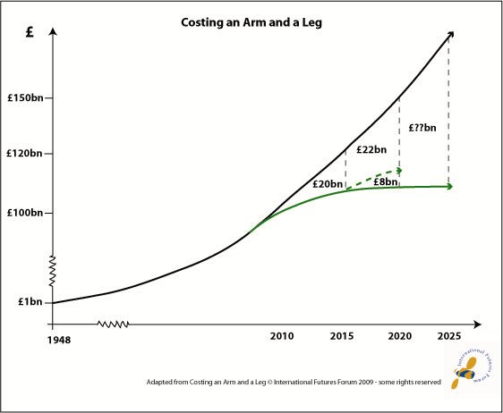
Notes:
Let’s start looking at the challenge facing the NHS today from a funding perspective.
Overall 3-4% annual increase in costs – demographics, patterns of disease, healthcare knowledge and technology.
Until 2010, funding for the NHS more or less matched the demand. This changed abruptly with the onset of austerity and now we have a mis-match of about 3% between the rise in healthcare costs and the amount of money to meet them.

Slide 6
Three Horizons
Making sense of the landscape of change through three perspectives on the future potential of the present moment
Pattern
Time

Slide 7
First Horizon: Sustaining Innovation
The managerial perspective, keeping things going
Pattern
Today’s Dominant Pattern: a system losing strategic fit and therefore dominance over time
H1
Time

Slide 8
Third Horizon: Transformative Innovation
The visionary perspective, aspiring to a better way
The Future Pattern: a system in tune with deeper trends that eventually emerges as the new dominant system—perhaps a generation from now
Pattern
H3
Time

Slide 9
Second Horizon: Disruptive Innovation
The entrepreneurial perspective, eager to try new things
–
sustaining
transformative
Pattern
+
Zone of Transition: a system seeking to exploit the opportunities emerging in a changing world
H2
Time

Slide 10
Three Horizons: Bringing it Together
A transformative innovation system that contains three ways of acting in and seeing the world.
Pattern
H1
Manager
H2
Entrepreneur
H3
Visionary
Time

Slide 11
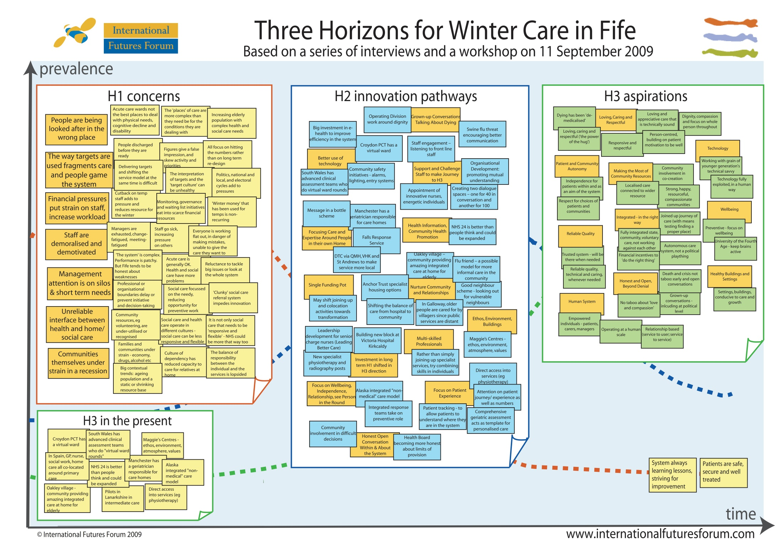

Slide 12
Notes:
Did some further processing of the information from the workshop, drawing out value patterns for H1 and H3. It was here I began to realise how we grow a different system by living its values – list the H3 values. H1 values still have their place, but in the service of H3 not at its expense.
Further distilling of H2 led to 6 promising pathways which the team I’ve worked with have been using ever since. When opportunities arise, we know how to direct our efforts.
Increasingly the practice is becoming a way of “introducing the new in the presence of the old”, working with the dilemmas which we encounter all the time in the process.

Slide 13
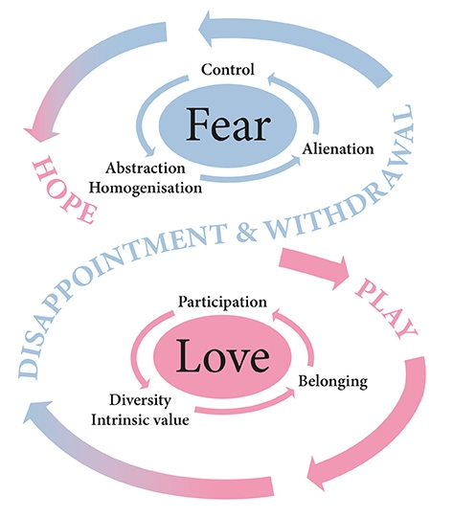

Slide 14
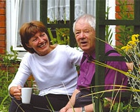
Fife Shine Programme
Find ways for older people to thrive, not just survive at home.
Explore what matters to people, solution-focused approaches
Develop quality relationships to co-create solutions with family, neighbours and community

Slide 15
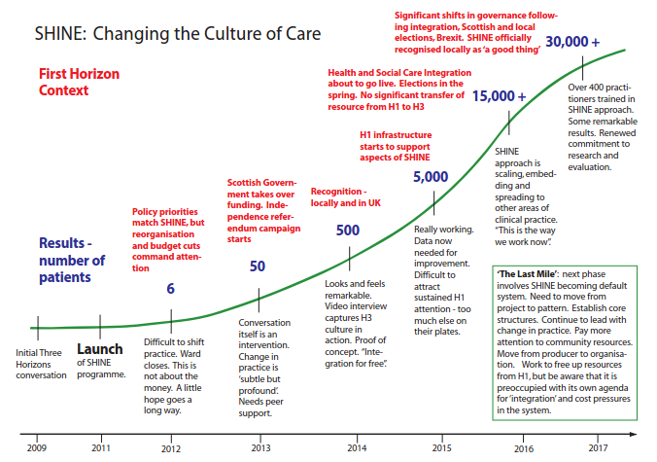

Slide 16
A Case Study in Systems Change in Health and Social Care
Part One:
Conceptual Architecture
Part Two:
The Story of SHINE
Part Three:
The Last Mile
Part Four:
What Works?
2018

Slide 17
Transformative Innovation
Shifting systems to a new pattern of viability fit for the future rather than just fixing what’s failing in the present. Growing the new in the presence of the old.

Slide 18
Three Horizons reprise
A transformative innovation system that contains three ways of acting in and seeing the world.
Pattern
H1
Manager
H2
Entrepreneur
H3
Visionary
Time

Slide 19
Three Horizons Voices and Relationships
Shifting from negative mindsets to positive perspectives enables people to work across horizons and facilitate the conditions for transformative change.
Negative Mindsets
Positive Perspectives
H1
H1
Too Risky
Ideas
Irrelevant
Obstructive
Hope
Support
H2
H2
Dinosaur
Impractical
Scale
Inspiration
Compromise
Ally
H3
H3

Slide 22
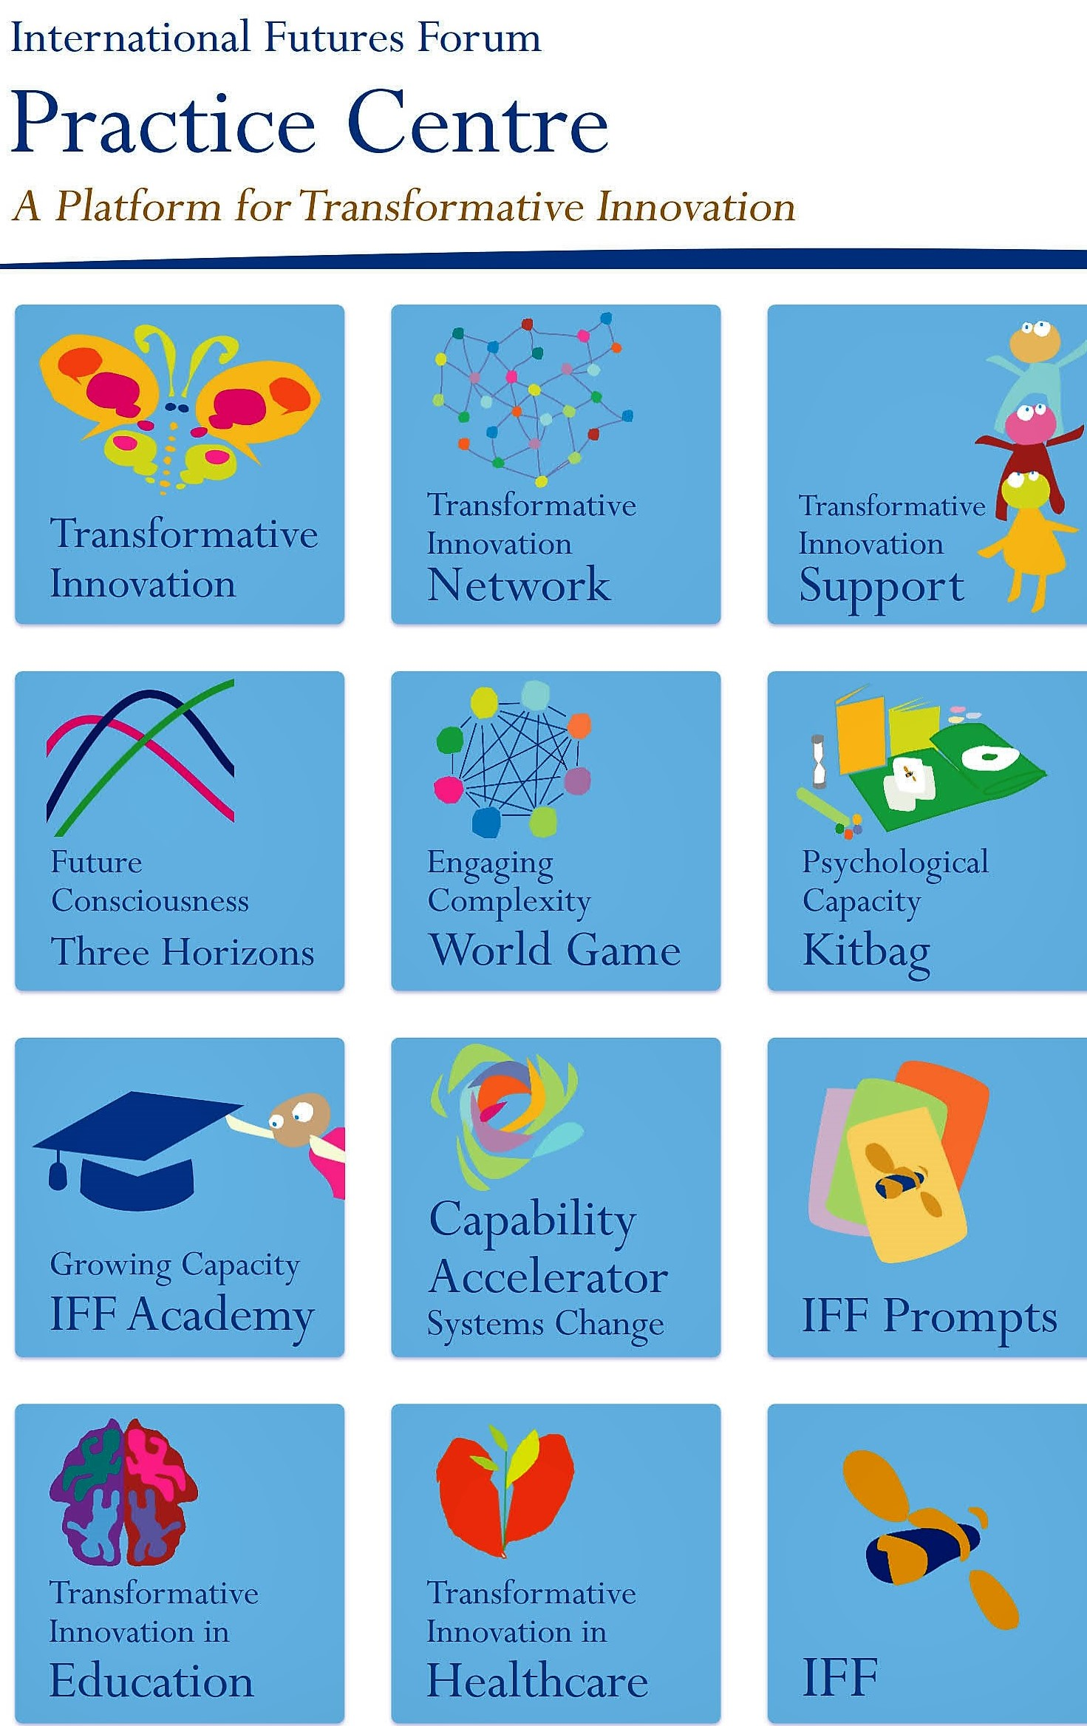
An Invitation…
to join our Transformative Innovation Network
www.iffpraxis.com

Slide 23
Thank you
margaret@internationalfuturesforum.com
@margaret_iff
www.iffpraxis.com

