Slide 1
Working on Transition
With Duncan Wallace
What types of behaviours are needed to do this…
‘Bounce-back-ability’
“The belief that leaders have the endless
stamina, ideas, and skills it takes to deliver
success year after year is a fallacy of the past “

Slide 2
Bridges Model of Transition

Slide 3
The 4 Ps
Purpose Explain the basic purpose behind the change. Help them understand the logic behind the change before they apply their minds to it. | Picture Paint them a picture of how the future will look and feel. Let them imagine it first before committing to it.
Plan Lay out the plan for phasing in change. Provide a clear sense of direction. | A Part to Play Show people the part each of them plays in the future and how they contribute. Each of us will find one or two of these factors more important than the others. Some of us need to understand the Purpose, others need the Picture. For some a detailed Plan is necessary, while others need reassurance that everyone has a Part to Play.

Slide 4
Readiness and Capability Preparation
Key People / Groups | Readiness (Commitment / Willingness) |  |  | Capabilities (Power / Influence)
 | High | Med | Low | High | Med | Low

Slide 5
Notes:
Riding the waves
Insert questions

Slide 6
is the
New Normal
www.duncanwallace.org.uk

Slide 7
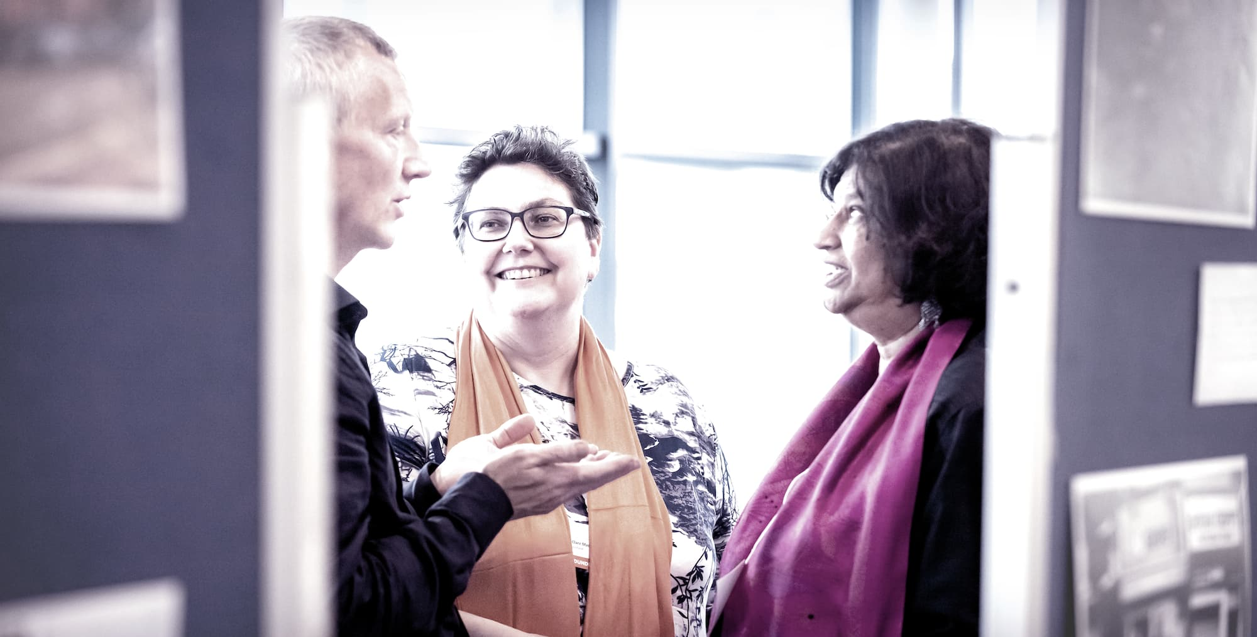
“Bringing Life to Organisational Change” www.margaretwheatley.com
“We ignore people’s need to participate at our own peril. If they’re involved , they will create a future that already has them in it…People support what they create”
“Life accepts only partners, not bosses.”

Slide 8
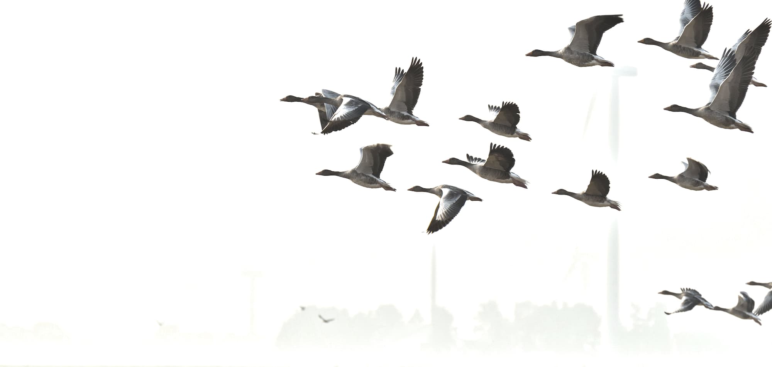
You.

Slide 9
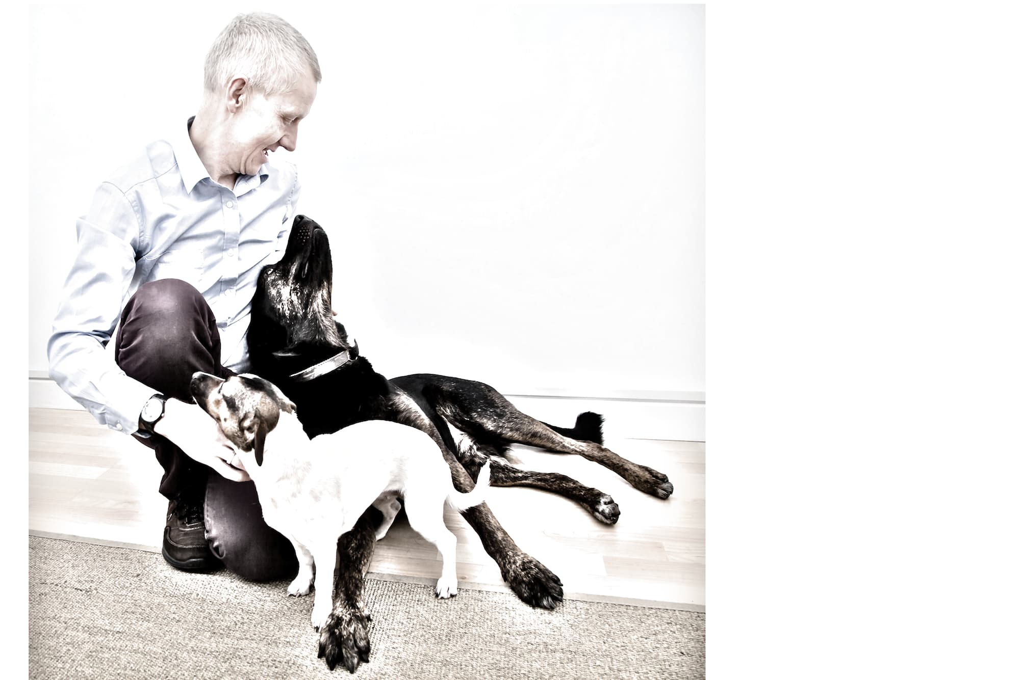
Coaching, Training, Facilitation and Organisational Transformation work.
w: www.duncanwallace.org.uk
e: duncan@duncanwallace.org.uk
T: 07786050893

