Slide 1

Edinburgh Partnership
“Edinburgh is a thriving, connected, inspired and fair city, where all forms of poverty and inequality are reduced.”
Michele Mulvaney - Strategy Manager (Communities), City of Edinburgh Council

Slide 2
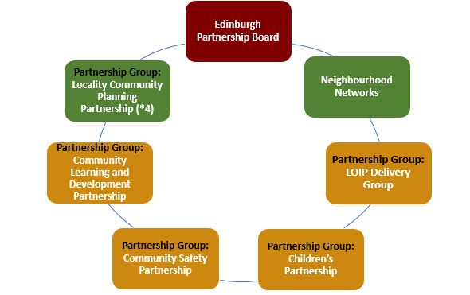
Governance framework

Slide 3
Edinburgh Partnership Board
Accountable body for community planning in the city
Responsible for overseeing, developing and monitoring all matters relating to the Edinburgh Partnership
Membership comprises public bodies, business, voluntary and community sectors

Slide 4
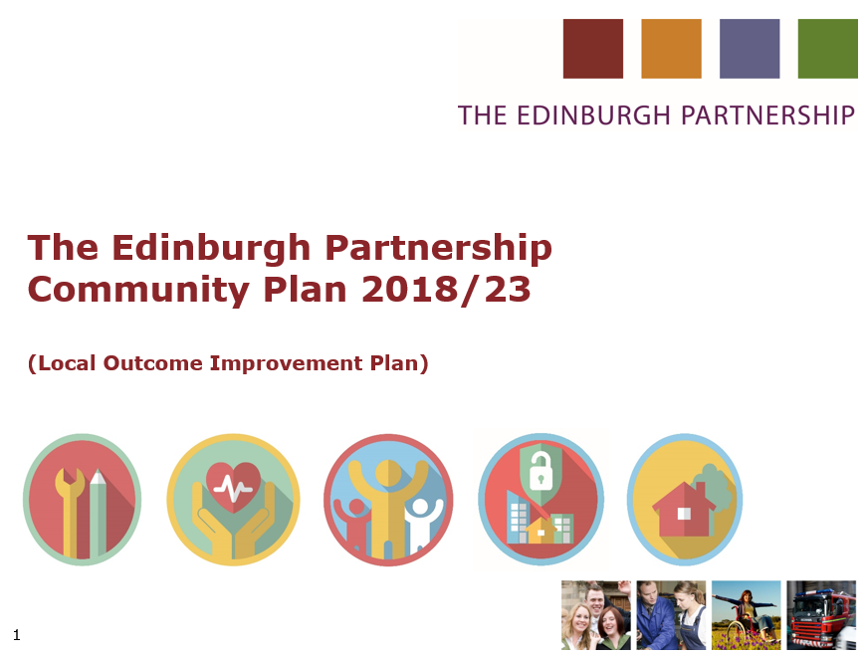
Local Outcome Improvement Plan - Delivery Group
Responsible for the development and delivery of the local outcome improvement plan (community plan)
Membership comprises public bodies, third sector interface, community of interest

Slide 5
What Outcomes?
LOIP
Enough money to live on
Access to work, learning and training
A good place to live

Slide 6
Locality Community Planning Partnerships
Responsible for the development and delivery of the Locality Improvement Plan
Membership comprises public bodies, community from neighbourhood networks, third sector, elected members

Slide 7
What Outcomes?
LIP
Children and Young People
Community Safety
Health and Social Care
Economy and Employability
Place

Slide 8
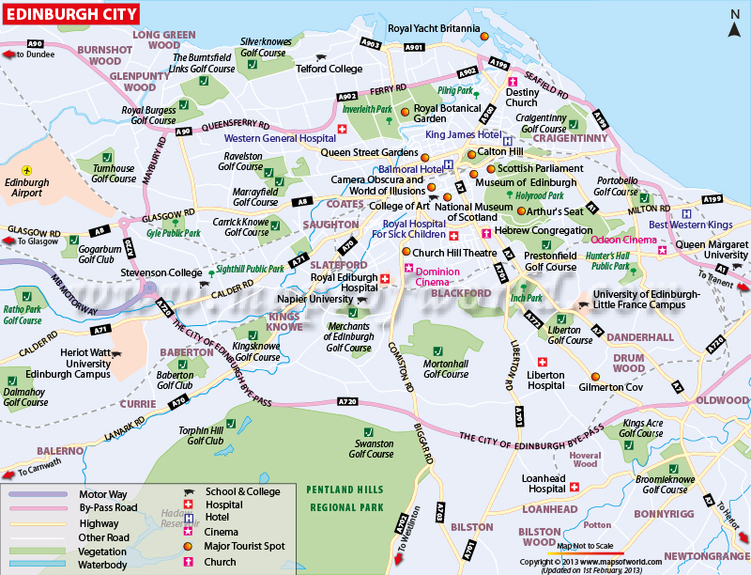
Neighbourhood Networks
Responsible for ensuring communities are engaged in community planning
Operating model left to local determination
Made up of community bodies, third sector organisations, and elected members

Slide 9
For more information email: communityplanning@edinburgh.gov.uk

