Slide 1
Edinburgh Community Health Forum
JSNA Summary
Jessica Pearson, Population Health Project Manager

Slide 2

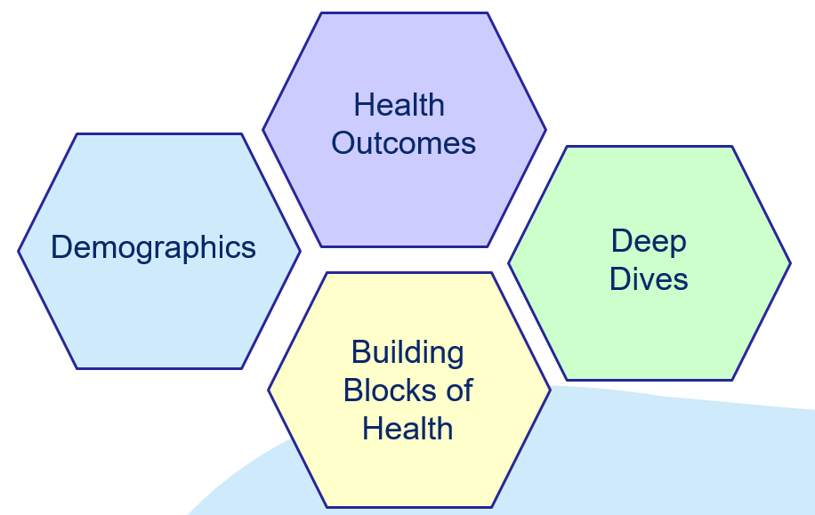
Children, Young People and Families JSNA
CYP JSNA
Notes:
A JSNA is a systematic attempt to assess the current and future needs of local populations to inform and guide the planning and commissioning of services. We’ve done this for the children, young people and families of Edinburgh.
We’ve taken a collaborative approach to this project through stakeholder interviews and partnership work with data intelligence. It’s broken down into 4 main chapters, demographics, health outcomes, building blocks of health which is structured around the Health Foundation Building Blocks of Health Framework and finally the deep dives. We’ve taken a further ‘deep dive’ focus into three specific areas; homelessness, additional support needs and universal access to healthy environments and opportunities including youth work i.e. Edinburgh’s universal offer to children and young people. Today I’m going to give you a summary of the findings and recommendations within some of these chapters before we have some time for discussion.

Slide 3
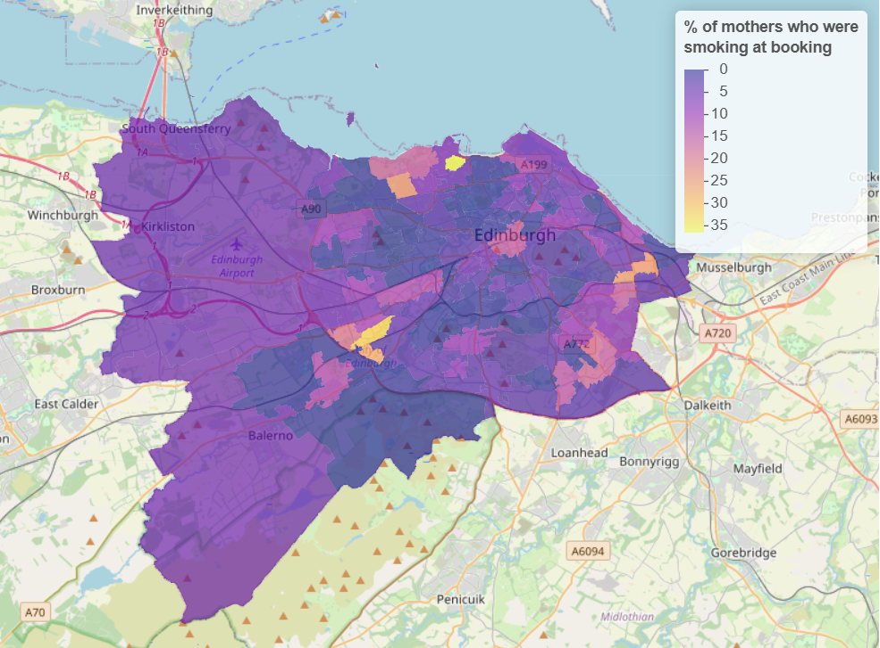
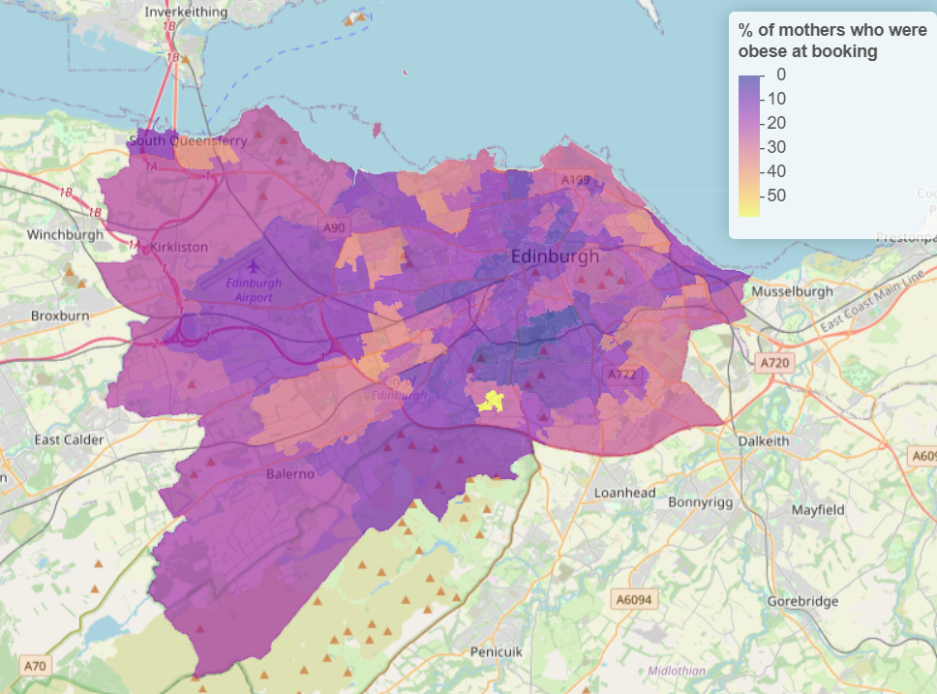
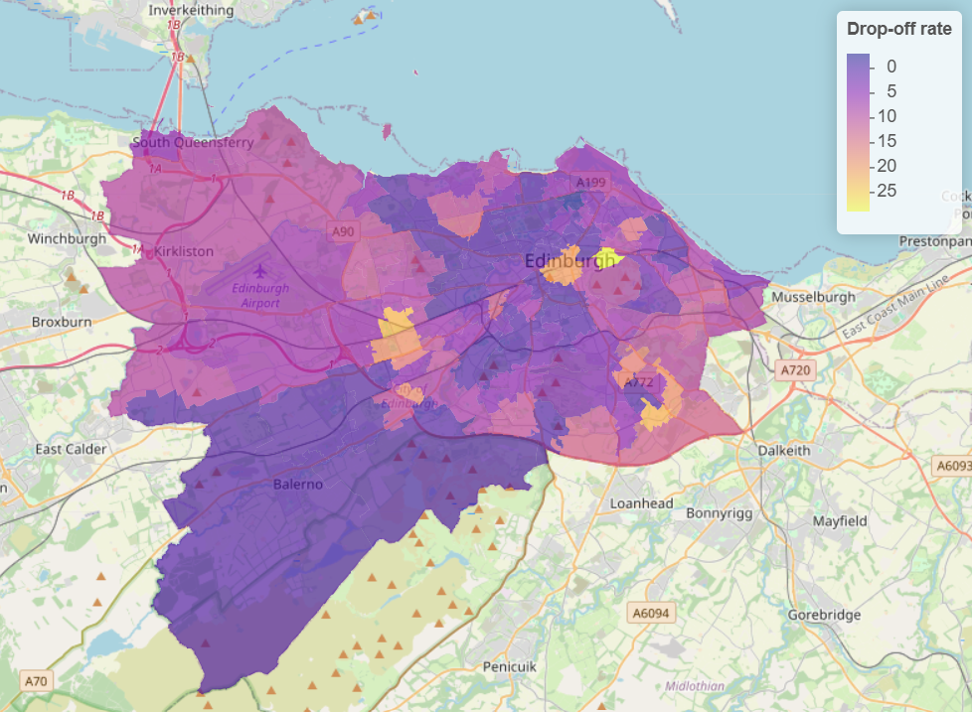
Key findings: Early years
Maternal smoking rates are low overall, but exceptions remain in some particular geographical areas
A quarter of pregnant people are recorded as obese at maternity booking
Around 70% of babies are breastfeed at 6-8 weeks but drop-off is patterned by deprivation
Developmental milestones and immunisation update also continue to be patterned by deprivation
Key findings (I)
Maternal smoking
Maternal obesity
Breastfeeding drop-off
Discovery from PHS - data not publicly available
Discovery from PHS - data not publicly available
Child Health Systems Programme Pre-School, Public Health Scotland

Slide 4
Key findings: Health outcomes
Average rates of healthy weight and dental health are better that the Scottish average but are still patterned by deprivation
For young people aged 15-24 the most common causes of years lost to disability across the life course are mental health, headache disorder and musculoskeletal disorders
National survey data shows a significant number of older children and young people reporting issues with mental health and wellbeing
Key findings (II)
2021-22 Health and Wellbeing Census
Notes:
This data is from the 2021-22 Health and Wellbeing Census which uses the Strengths and Difficulties Questionnaire to assess mental health among children and adolescents in S2-S6. Over half of female respondents in scored as having raised levels of mental health and wellbeing difficulties, while the rate for males was lower (34.5%) but still substantial.

Slide 5
Recommendations: Early years & health outcomes
Ensure that City Plan 2040 and other relevant local policies includes requirements for public spaces to support key aspects of early years and children and young people’s development…
Support the most vulnerable families to access structured play and childcare opportunities…
Support all staff working with early years children and families in Edinburgh to feel able to raise key topics of smoking, healthy weight, breastfeeding, healthy development and immunisations as part of routine supportive conversations they are having with families.
Explore options for protection from harmful commercial determinants of health such as exposure to advertising for the retail of health-harming commodities including tobacco, alcohol and foods high in fat, sugar and salt
Continue to ensure that children and young people in schools and other settings such as youth work have access to relevant health promoting information and confident staff who can support them to engage with relevant services...
Ensure a joined up and effective approach to the provision of opportunities and support for young people’s mental health and wellbeing, including through access to physical activity, youth work and mental health and wellbeing services, including those currently provided through Whole Family Wellbeing Fund, Connected Communities and Community Mental Health Grant programmes.
Recommendations (I)

Slide 6
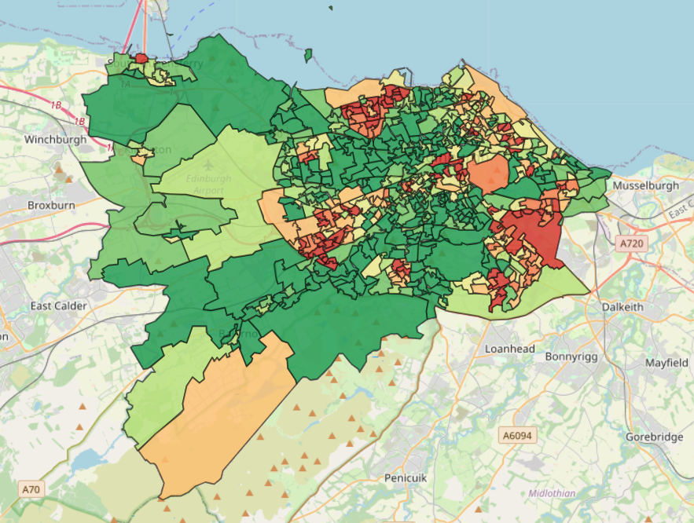
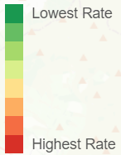
Key findings: Building blocks of health
Money and resources: 20% of our children live in poverty.
Good work: 65% of low-income families in the city remain on low incomes despite being in work.
Housing: Around 3000 children in the city live in temporary accommodation.
Surroundings: Only 40% of school-age children in SIMD 1 think their area is a good place to live, compared with over 80% in SIMD 5.
Key findings (III)
Children in low income families: local area statistics 2014 to 2021 - GOV.UK
Department for Work and Pensions
Notes:
This map shows the percentage of children in poverty, Edinburgh, 2020/21 based on relative income measure of children in low income families before housing costs. The report shows the child poverty rates after housing costs too which we know was at 20% in 2022/23. I think most of the group here today will know these figures but we hope that presenting these in the final report with the links to the data will not only give context to some of the other information but also support people to reference the data in their work.
We also highlight the issue of in-work poverty which hasn’t reduced dramatically in the last few years and is currently at 65% and slightly higher than the figures for Scotland.
The chapter on housing discusses the importance of affordable, stable and quality housing but there is also a deep dive into homelessness which takes this much further and highlights the numbers of children in temporary accommodation which is currently at 3000.
Then we move into the impact of our surroundings on health and well being, delving into access to clean air, greenspace, safe neighbourhoods and the importance of healthy retail environments. A key finding is children’s perceptions of the place where they live which unsurprisingly is much better for those living in SIMD 5 compared with SIMD 1.

Slide 7
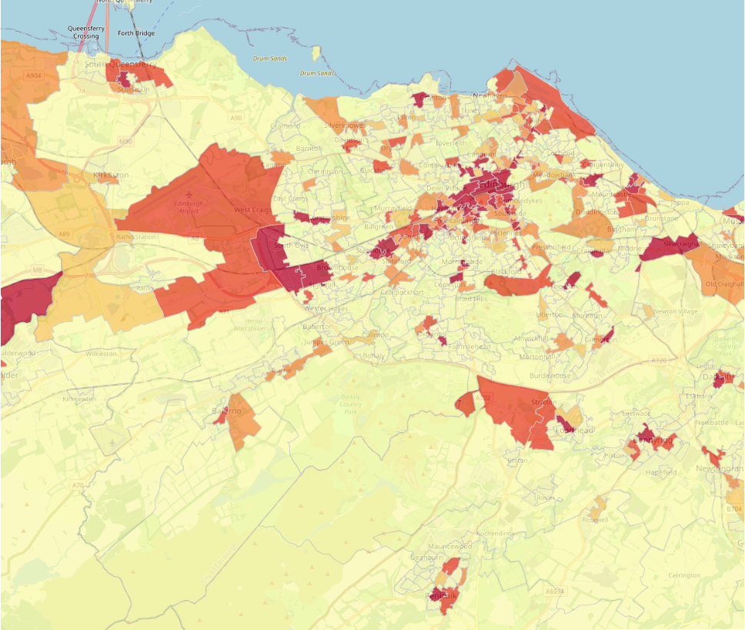
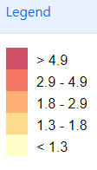
Key findings: Building blocks of health
Transport: Over 80% of children have taken up their bus pass entitlement, but over a quarter are still being driven to school.
Food: Exposure to hot food takeaways (associated with less healthy options) are concentrated in areas of higher deprivation and over 20% of children say they sometimes go to bed hungry.
Key findings (IV)
Source: creshmap.com

Slide 8
Key findings: Building blocks of health
Education and skills: Educational attainment continues to be patterned by SIMD. 10% of children are not enrolled in early education (vs 3% in Scotland). Over a quarter of school age pupils reported not taking part in any organised activities outside of school.
Family, friends and community: Only 65% of young people report having an adult in their life who they could trust and talk to.
Key findings (V)
National Improvement Framework (NIF) - Schools - gov.scot, NIFIER Dashboard
Notes:
You can see from the graph that when it comes to educational attainment in P1, there is a marked difference in the proportion of children meeting the expected levels in key skills such as literacy and numeracy.

Slide 9
Recommendations: Building blocks of health
Money and resources: Ensure an accessible and equitable system of welfare advice is available…
Good work: Further explore options to support parents into ‘good work’, including options to expand flexible, affordable childcare in the local areas where this could make the biggest difference.
Housing: Continue to prioritise the needs of children and families in the allocation of housing, including ensuring that when temporary accommodation is needed mitigations are in place to minimise impacts
Surroundings: Ensure that equitable access to high quality, child and young people friendly greenspace for playing, is prioritised as part of all development and regeneration opportunities in the city.
Transport: Improve the transport environments around schools, prioritising those in the most deprived areas, and continue to encourage uptake and use of Free Bus Travel as well as exploring options for equitable access to bikes and effective cycle training.
Food: Continue to support pathways to food security, while also supporting emergency food providers to consider options for a Cash First approach wherever possible.
Education and skills: Continue the development and evaluation of the Team Around the Community…
Communities: Ensure that learning from the Whole Family Wellbeing Fund and other programmes of community-based work are embedded in routine mechanisms for supporting communities to improve access to key services.
Recommendations (II)

Slide 10
Deep dives : Homelessness
Findings:
Unique set of circumstances in Edinburgh which has led to declaration of the housing crisis
Health and wellbeing issues linked to long stays in temporary accommodation including impact on:
Sleep
Diet
Exercise and play
Physical health and access to healthcare
Mental health
In Their Own Words: Children's Experiences in Temporary Accommodation - Shelter Scotland
Deep Dives : Homelessness
Homelessness in Scotland: 2023-24 - gov.scot
Notes:
We found that the unique circumstances in Edinburgh, such as high housing costs and low proportion of social housing led to the housing crisis being declared in November 2023. Numbers of children in temporary accommodation rising (which is the accommodation offered by the council when someone becomes homeless before they move into permanent accommodation) and what’s unique to Edinburgh is the length of stay in temporary accommodation, particularly for families with children is very high. This poses some health and well being issues for the children which were highlighted in a recent report into the issue by Shelter Scotland. They interviewed children within this system and across Scotland and found some concerning themes around sufficient quality sleep related to sharing rooms and beds and worries about their situation. There are also knock on effects their education etc. Also diet quality linked to lack of sufficient facilities and reliance on food banks. There are also added barriers to exercise and play usually linked to lack of space but also concerns over the safety of their environment and being moved far away from friends. Existing health conditions are exacerbated by damp conditions in some housing and multiple relocations can lead to reduced access to healthcare and impacts on mental health due to lack of stability.

Slide 11
Deep dives : Homelessness
Recommendations:
Build on the ongoing mapping of services as part of the Housing Emergency Action Plan to identify gaps in locally accessible services for children and families and explore opportunities and potential mitigations.
Build on existing data sharing with health visitors and schools, considering opportunities for an improved two-way feedback system between housing, social work, healthcare and education to ensure better coordination and support for families, in line with UNCRC, GIRFEC and Promise principles.
Explore data to understand the number and nature of relocations which families experience within Temporary Accommodation placements recognising that, if new accommodation better meets households needs, the benefit of the move may outweigh the disbenefit from disruption to stability.
Explore opportunities to allow families in the homelessness system to maintain registration with current primary care services when relocating to temporary accommodation, in order to maintain continuity of care.
Deep Dives : Homelessness

Slide 12
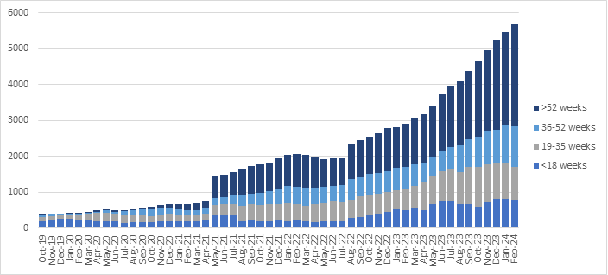
Deep dives : Additional Support Needs (ASN)
Findings:
NHS Lothian CAMHS ND waiting list growth
Deep Dives : ASN
SEEMIS Primary and SEEMIS Secondary files
IA-report-2024-Lothian-Neurodevelopmental-Framework-for-Children-and-Young-People
Notes:
We found dramatic increases in the demand for additional support services in education and rapid growth of the waiting list for neurodevelopmental assessment in NHS Lothian. These numbers are not a surprise for those working in these sectors and thus there is already a lot of work ongoing to address the increases. Education has done lots of work on the transformation of inclusion services to better meet this need and there has also been lots of work on the development of a pan-Lothian neurodevelopmental framework to support a consistent, high quality, multi-agency approach.

Slide 13
Deep dives : Additional Support Needs (ASN)
Recommendation:
Develop a multi-agency roll-out of an ASN-informed approach to ensure that additional support needs can be better accommodated in non-specialist environment
Deep Dives : ASN
Notes:
This is basically to ensure that the principles of the work going on in education and healthcare are mirrored in the services that families interact with outside of those sectors, throughout all of healthcare not just CAMHS and in all council run services and within third sector. So in a nutshell its really about creating an inclusive environment for children, where individual difference is accepted and understood as part of the normal variation among the population and services are set-up to expect this and be able to support all families.

Slide 14
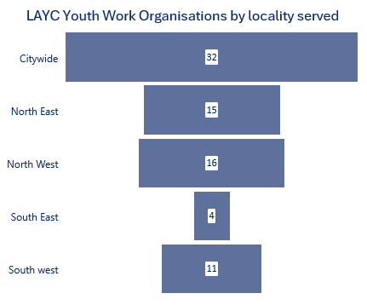
Deep dives : Universal Offer
Findings:
Early Years
Library membership
Physical Activity and Active Schools
Bikeability
Out of School Care (breakfast and after school clubs)
Youth Work
Childsmile
No clear consensus on what the Universal Offer is
Gaps in data
Gaps in service provision in SE
Deep Dives : Universal Offer
Shared internal LAYC data
Notes:
So for this chapter we were looking to assess what Edinburgh’s universal offer of access to healthy environments and opportunities for children and young people is and whether it meets the need? So we looked at various different areas including early years, libraries, physical activity, cycle training, out of school care, youth work and oral health. We found that whilst the best approach is to provide services universally with targeted interventions for those that need it most, there was actually no clear understanding of what Edinburgh’s offer consists of and lots of gaps in the data to assess whether we are meeting the need. There were also particular service provision gaps in the South East which many of you will be aware of already.

Slide 15
Deep dives : Universal Offer
Recommendations:
Carry out further work to develop and agree a Universal Offer of access to healthy environments and opportunities for children and young people
Continue to support the delivery of Youth Work in the city, recognising the key role it has to play in supporting children and young people to access a wider range of opportunities, support, and services
Deep Dives : Universal Offer

Slide 16
Recommendations: Overarching
Work as a Community Planning Partnership to systematically embed children’s voices in the planning of spaces, opportunities and services, including through City Plan 2040 and as well as in future Community Plans and Children’s Services Plans.
Work as a Community Planning Partnership to consider priorities areas where improved data collection, sharing or analysis would enable us to make more informed policy decisions and service improvements
Consider further workforce development including on neurodiversity and trauma-informed practice to ensure frontline staff across all services working with children, young people recognise and respond to the individual needs of each child, young person and family in a compassionate, adaptable and supportive way.
Recommendations (IV)
Notes:
Any surprises?
How does this relate to your work?

